Slide 1
Partner Technical Boot Camp
Leveraging Runbooks to Automate Azure Tasks
Notes:
Preparation: Watch https://www.youtube.com/watch?v=EAn9RTQCBQM it's very good

Slide 2
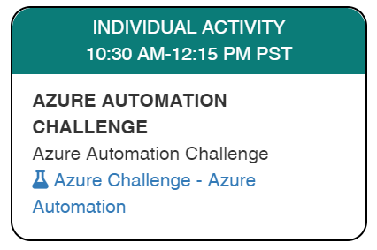
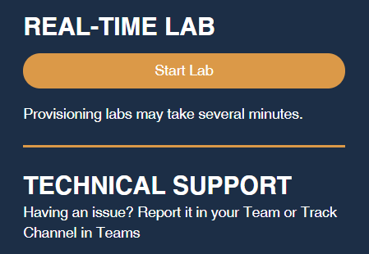
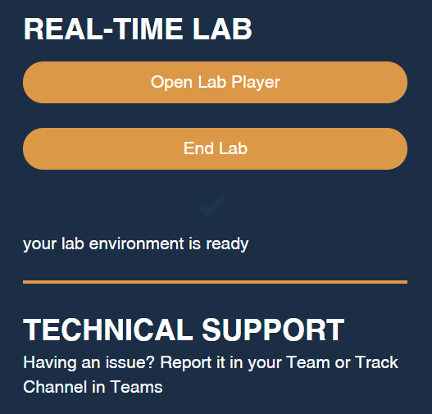
Launch the Lab Environment – NOW
Important! Allow at least 1 hour for your lab to start

Slide 3
Agenda
Multi-Tenant Runbooks
Child Runbooks
Notes:
[Note: Was originally going to include section on Parallelization using PowerShell Workflow, but given time limit of just 45 minutes for this session, that's not going to fit.]

Slide 4
Multi-Tenant Runbooks

Slide 5
Two Approaches
Lighthouse
Any subscription
Subscription owner must enrol
Users/Groups specified up-front
Roles specified up-front
Admin-On-Behalf-Of (AOBO)
CSP only
No enrolment – covers all CSP subscriptions
Any member of AdminAgents group
Owner role only

Slide 6
Azure Automation with Lighthouse – Set Up
Create Automation Account with RunAs account
Identify required roles
Include RunAs ObjectId and role IDs in Lighthouse configuration
Or assign to group
Customer signs up and delegates access
Given role is assigned to RunAs account for customer subscription
Hard to change roles later – requires customer action

Slide 7
Lighthouse Runbook
# Connect to Azure using RunAs account Disable-AzContextAutosave –Scope Process $Conn = Get-AutomationConnection -Name AzureRunAsConnection Connect-AzAccount -ServicePrincipal ` -Tenant $Conn.TenantID -ApplicationId $Conn.ApplicationID ` -CertificateThumbprint $Conn.CertificateThumbprint
# RunAs account has access to cross-tenant resources via Lighthouse Write-Output "Listing subscriptions with Get-Subscription" Write-Output "Uses old API version and doesn't show homeTenantID" Get-AzSubscription
# To see tenantId for subscriptions, need to use latest API version # Call REST API directly passing bearer token Write-Output "Now list subscriptions using latest API" $uri = 'https://management.azure.com/subscriptions?api-version=2020-01-01'
$token = ((New-Object Microsoft.Azure.Commands.ResourceManager.Common.RMProfileClient([Microsoft.Azure.Commands.Common.Authentication.Abstractions.AzureRmProfileProvider]::Instance.Profile)).AcquireAccessToken((Get-AzContext).Tenant.TenantId)).AccessToken
$subscriptions = Invoke-RestMethod -Uri $uri -Method Get -UseBasicParsing ` -Headers @{ 'authorization' = "Bearer $token" }
Write-Output $subscriptions.value

Slide 8
Azure Automation with AOBO
Create Automation Account
Run script to
Create Enterprise Application in AAD → application ID and client secret
Create Service Principal associated with Enterprise Application
Add Service Principal to the AdminAgents group in AAD
Complete consent process → refresh token
Default renewal is 90 days
Store data in Automation Account variables
Encrypt the client secret and refresh token
https://docs.microsoft.com/powershell/partnercenter/secure-app-model

Slide 9
AOBO Runbook
param($tenantId)
# Load variables and make credentials object $appSecret = Get-AutomationVariable -Name 'ApplicationSecret' $appId = Get-AutomationVariable -Name 'ApplicationID' $refreshToken = Get-AutomationVariable -Name 'RefreshToken'
$pwd = ConvertTo-SecureString $appSecret -AsPlainText –Force $cred = New-Object System.Management.Automation.PSCredential ($appId, $pwd)
# Get tokens using $refreshToken $azureToken = New-PartnerAccessToken -RefreshToken $refreshToken ` -Scopes 'https://management.azure.com/.default' ` -Credential $cred -Tenant $tenantId -ApplicationId $appId -ServicePrincipal
$graphToken = New-PartnerAccessToken -RefreshToken $refreshToken ` -Scopes 'https://graph.microsoft.com/.default' ` -Credential $cred -Tenant $tenantId -ApplicationId $appId -ServicePrincipal
$azureAdToken = New-PartnerAccessToken -RefreshToken $refreshToken ` -Scopes 'https://graph.windows.net/.default' ` -Credential $cred -Tenant $tenantId -ApplicationId $appId -ServicePrincipal
# Connect to Azure and Azure AD Disable-AzContextAutosave –Scope Process
Connect-AzAccount -AccessToken $azureToken.AccessToken ` -GraphAccessToken $graphToken.AccessToken ` -TenantId $tenantId -AccountId $appId
Connect-AzureAD -AadAccessToken $azureAdToken.AccessToken ` -MsAccessToken $graphToken.AccessToken ` -TenantId $tenantId -AccountId $appId

Slide 10
Multi-Tenant Runbooks
Demo

Slide 11
Child Runbooks

Slide 12
Child Runbooks
Invoke one runbook from another
Example scenarios
Decompose complex tasks
Reusable scripts
Parallelize repeated activities
For example, applying a change to several subscriptions or tenants
Work around 3-hour 'fair share' limit

Slide 13
Two Approaches
 | Inline | Start-AzAutomationRunbook
Job | Same as parent | Separate job
Execution | Parent runbook waits for child to complete Cannot call child on Hybrid Worker from parent running in Azure | Parent runbook continues in parallel with child, unless -wait specified No Hybrid Worker constraints
Parameters | Any object | Simple, array, and objects supporting JSON serialization (use variables to pass/return complex objects)
Output | Child returns output to parent | Parent can check child status and retrieve output from child job (or, use -wait for direct access)
Scope | No calls across Workflow / non-Workflow runbooks Same Automation Account as parent | Any runbook, any Automation Account
Publishing | Child must be published before parent (does not apply to subsequent updates) | No constraints

Slide 14
Inline Examples
PowerShell
$out = .\MyChildRunbook.ps1 ` -text "mytext"
PowerShell Workflow
$out = MyChildRunbook `
-text "mytext"

Slide 15
Cmdlet Examples
Synchronous
$params = @{ 'text'='bananas' } $out = Start-AzAutomationRunbook ` -Name $runbookName ` -ResourceGroupName $rgName ` -AutomationAccountName $aaName ` -Parameters $params ` -Wait
Asynchronous
$params = @{ 'text'='bananas' } $job = Start-AzAutomationRunbook ` -Name $runbookName ` -ResourceGroupName $rgName ` -AutomationAccountName $aaName ` -Parameters $params
# Poll job status while ($job.Status -notin @('Completed', 'Failed')) {
Start-Sleep 2
$job = Get-AzAutomationJob ` -Id $job.JobId ` -ResourceGroupName $rgName ` -AutomationAccountName $aaName
}
# Retrieve job output $out = (Get-AzAutomationJobOutput ` -Id $job.JobId ` -ResourceGroupName $rgName ` -AutomationAccountName $aaName ` -Stream Output).Summary
Top Tip Format child runbook output as hash table for easy consumption by parent

Slide 16
Child Runbooks
Demo

Slide 17
Thank you.

